Slide 1
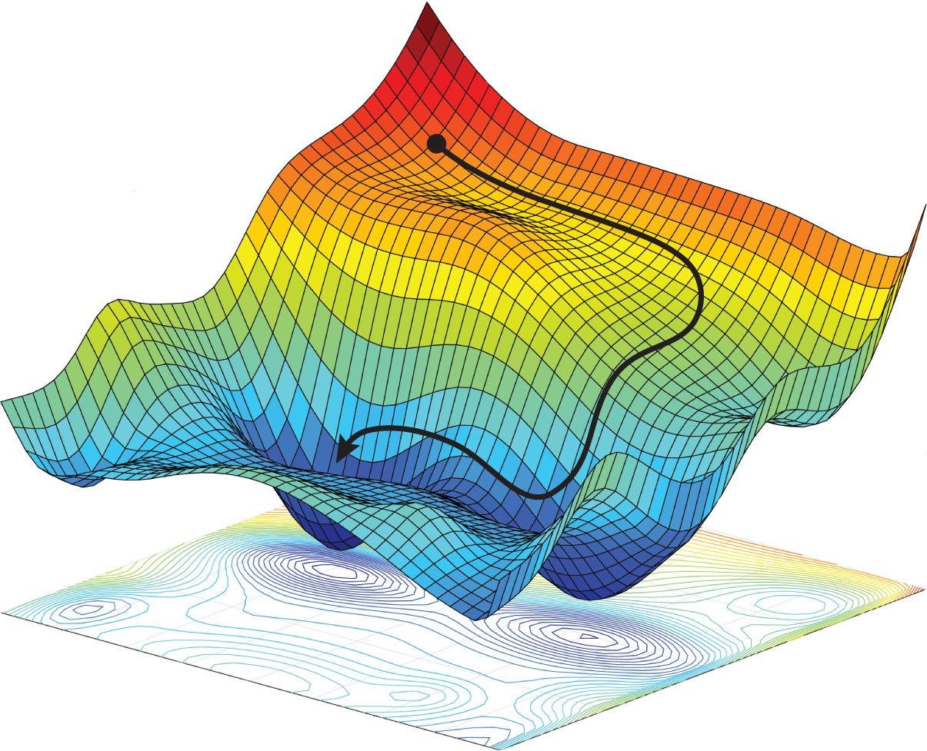
GAN Loss Functions
Memes are fun, add a meme about GANS to break the ice
Week 10: (03/25/2022)
Team Lead: Christian Zamiela
GANS DIS Spring 2022

Slide 2
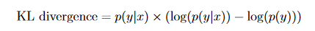
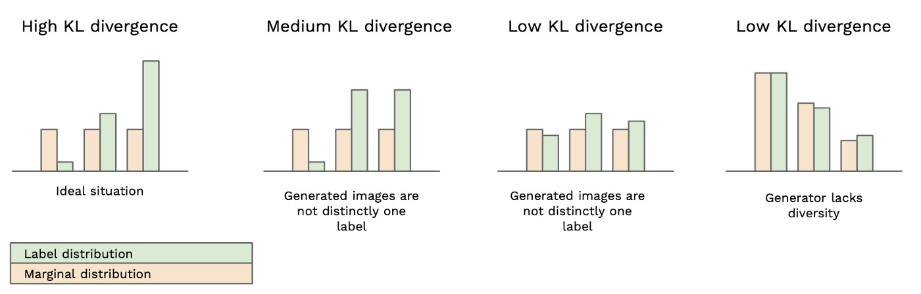
Recap: Evaluating GANS
Inception Score
Uses external Inception Module
Evaluates Generated images on Quality and Diversity

Slide 3
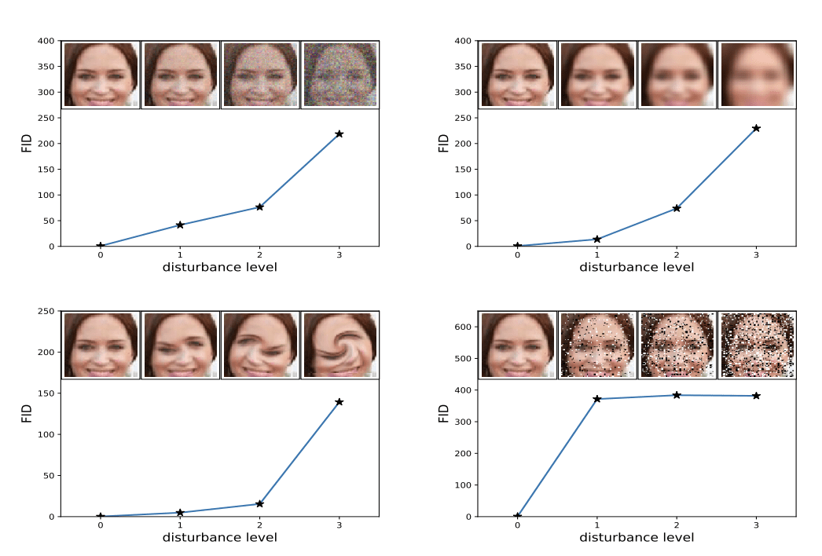
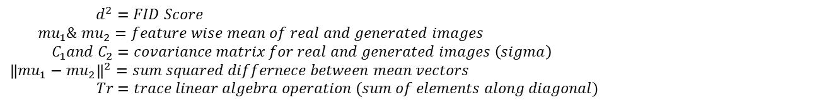
Recap: Evaluating GANS
Frechet Inception Distance (FID)
Improvement on the Inception Module
Calculates the Quality of generated images based on the distance between the distributions of the real and generated image sets
Lower Score = Higher Quality
$$d^{2}={\left\|mu_{1}−mu_{2}\right\|}^{2}+Tr(C_{1}+C_{2}−2×\sqrt{C_{1}×C_{2}})$$
$d^{2}=FID Score$
$$mu_{1}\& mu_{2}=feature wise mean of real and generated images$$
$${ C}_{1}and C_{2}=covariance matrix for real and generated images \left(sigma\right)$$
$${\left\|mu_{1}−mu_{2}\right\|}^{2}=sum squared differnece between mean vectors$$
$$Tr=trace linear algebra operation (sum of elements along diagonal)$$

Slide 4
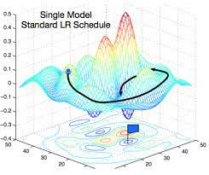
Objective
To improve GAN convergence by implementing changes to loss function for better image generation.
Chapter 14: How to Use Different GAN Loss Functions
Standard GAN loss function and how to use it
Least Squares GANS
Wasserstein GAN
Effect of Different GAN Loss Functions

Slide 5
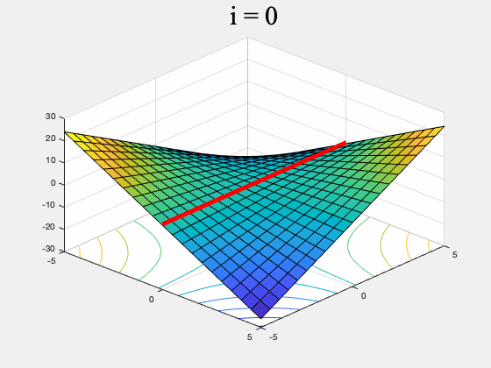
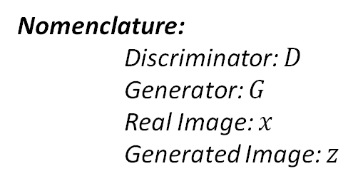
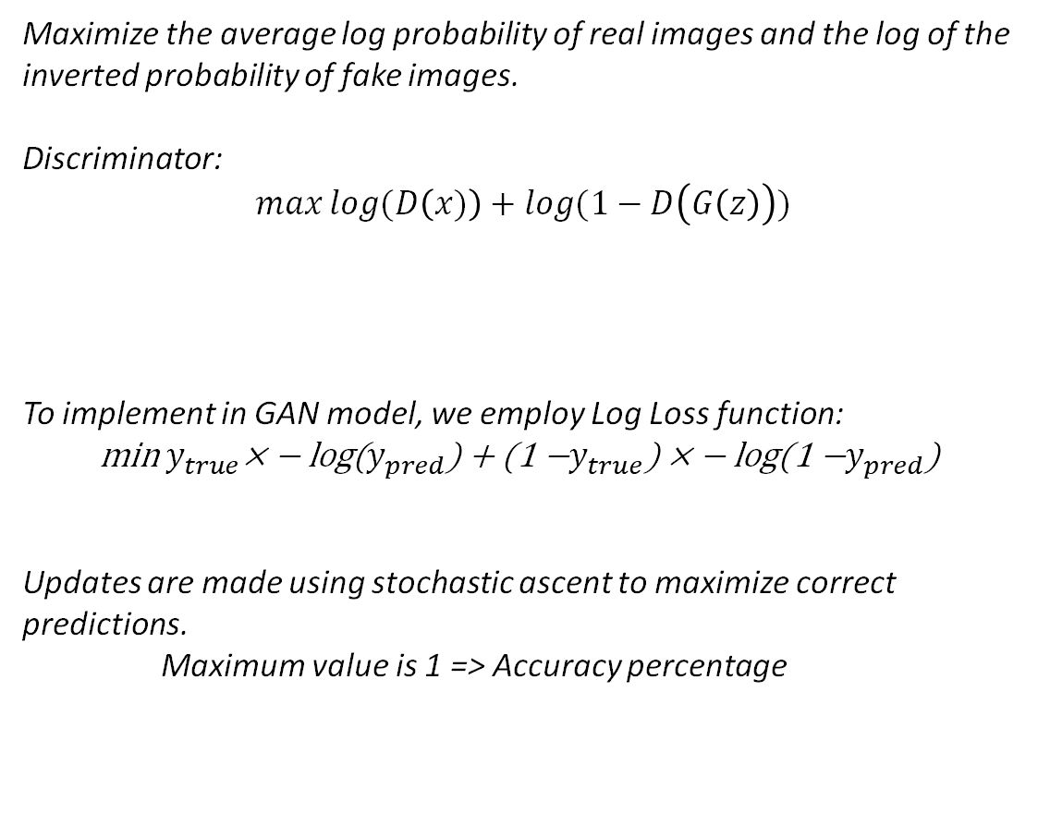
Standard GAN Loss Function: Discriminator
Maximize the average log probability of real images and the log of the inverted probability of fake images.
Discriminator:
$$\max{\log{(D\left(x)\right)+log⁡(1−D\left(G\left(z\right)\right))}}$$
To implement in GAN model, we employ Log Loss function:
$$\text{m}\text{in} y_{true}\text{× − }\text{log}\text{(}y_{pred}\text{) + (1 −}y_{true}\text{) × − }\text{log}\text{(1 −}y_{pred}\text{) }$$
Updates are made using stochastic ascent to maximize correct predictions.
Maximum value is 1 => Accuracy percentage
Nomenclature:
Discriminator: $D$
Generator: $G$
Real Image: $x$
Generated Image: $z$
Average log probability of real images
Inverted probability of fake images

Slide 6
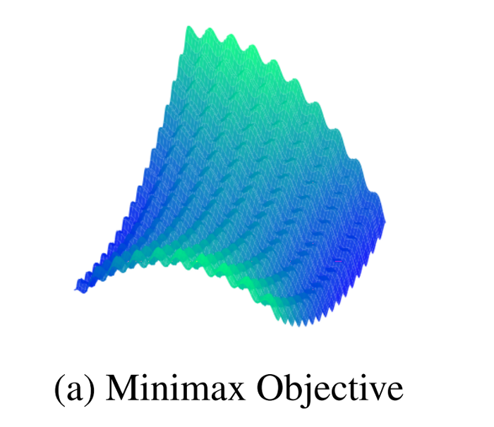
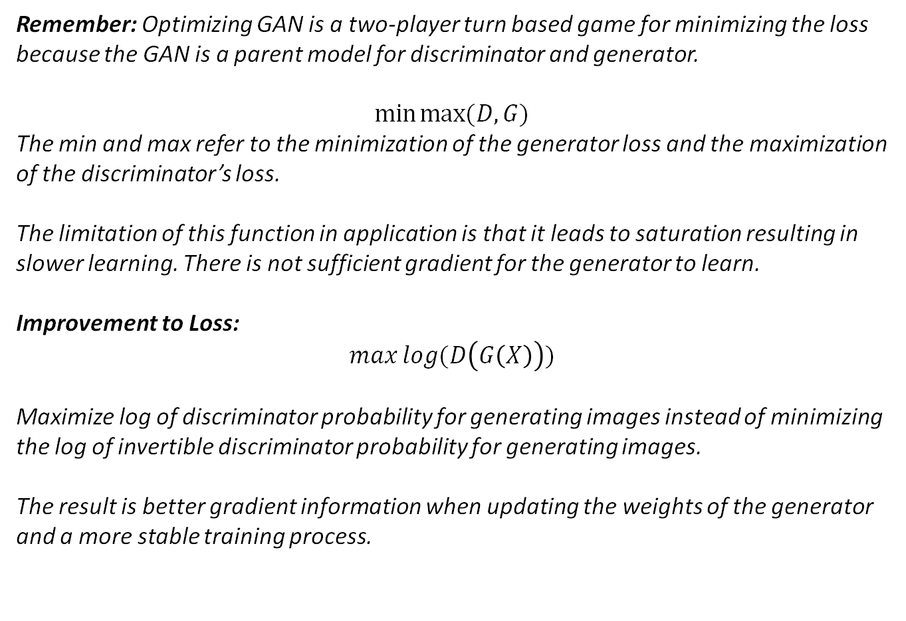
Standard GAN Loss Function: GAN
Remember: Optimizing GAN is a two-player turn based game for minimizing the loss because the GAN is a parent model for discriminator and generator.
$$\min{max⁡(D,G)}$$
The min and max refer to the minimization of the generator loss and the maximization of the discriminator’s loss.
The limitation of this function in application is that it leads to saturation resulting in slower learning. There is not sufficient gradient for the generator to learn.
Improvement to Loss:
$$\max{log⁡(D\left(G\left(X\right)\right))}$$
Maximize log of discriminator probability for generating images instead of minimizing the log of invertible discriminator probability for generating images.
The result is better gradient information when updating the weights of the generator and a more stable training process.

Slide 7
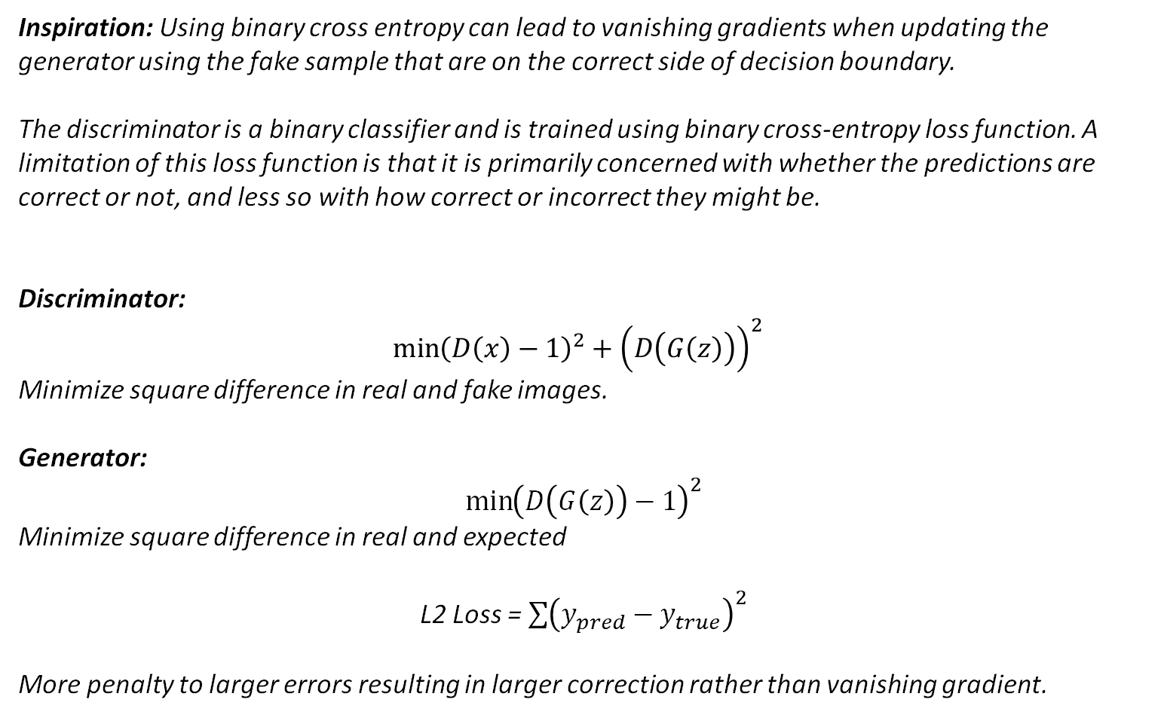
Least Squared GANS Loss
Inspiration: Using binary cross entropy can lead to vanishing gradients when updating the generator using the fake sample that are on the correct side of decision boundary.
The discriminator is a binary classifier and is trained using binary cross-entropy loss function. A limitation of this loss function is that it is primarily concerned with whether the predictions are correct or not, and less so with how correct or incorrect they might be.
Discriminator:
$$\min{{\left(D\left(x\right)−1\right)}^{2}+{\left(D\left(G\left(z\right)\right)\right)}^{2} }$$
Minimize square difference in real and fake images.
Generator:
$${\min\left(D\left(G\left(z\right)\right)−1\right)}^{2}$$
Minimize square difference in real and expected
L2 Loss = $\sum{{\left(y_{pred}−y_{true}\right)}^{2}}$
More penalty to larger errors resulting in larger correction rather than vanishing gradient.
Notes:
Reduces saturation and creates a curve to allow stable training.

Slide 8
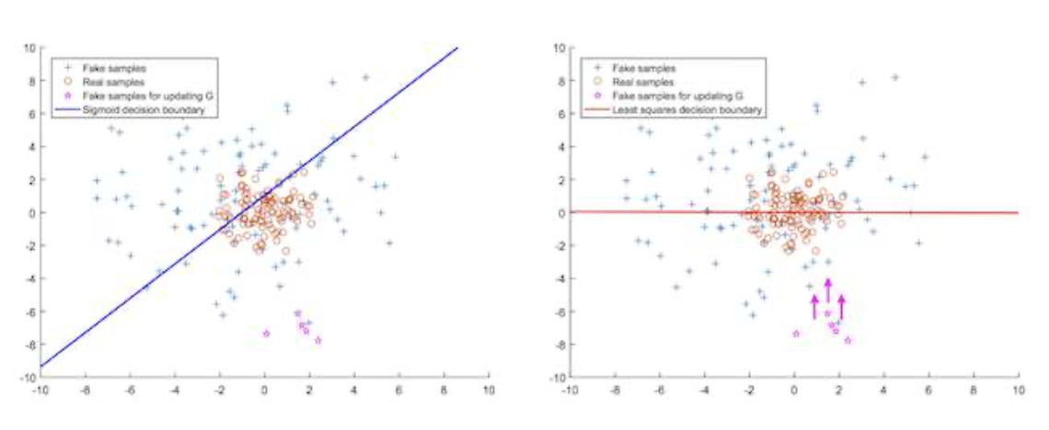
Implementing Least Squared GANS Loss
For Discriminator and Parent Models Code implementation.
Loss: MSE
Activation: Linear
The motivation for this change is that the least squares loss will penalize generated images based on their distance from the decision boundary.
Sigmoid Decision Boundary Least Squares Decision Boundary
Notes:
This will provide a strong gradient signal for generated images that are very different or far from the existing data and address the problem of saturated loss.
Gradient (Decision boundary) is moved closer

Slide 9
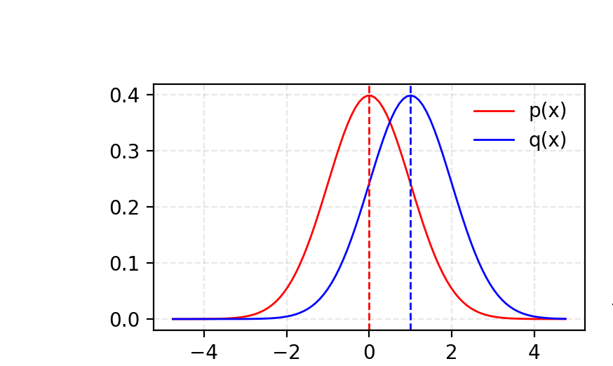
Wasserstein GAN Loss (WGAN)
Original Motivation: Aims to minimize the distance between the actual and predicted probability distribution for real and generated images.
KL Divergence calculates the distance between two probability distributions in terms of cost of tuning one distribution.
New Motivation: Turning the model away from probability distributions and instead rating the images like the inception model.
Wasserstein turn discriminator into a critic that updates five times more often than generator.
WGAN is that the training process is more stable and less sensitive to model architecture and choice of hyperparameter configurations.
Notes:
They demonstrate that a critic neural network can be trained to approximate the Wasserstein distance, and, in turn, used to effectively train a generator model. Importantly, the Wasserstein distance has the properties that it is continuous and differentiable and continues to provide a linear gradient, even after the critic is well trained.

Slide 10
Wasserstein GAN Loss (WGAN)
Wasserstein loss moves away from probability distributions and provides a critic scoring value for real and fake images.
Critic Loss = [average critic score on real images] - [average critic score on fake images]
Generator Loss = -[average critic score on fake images]
Small Critic Score (e.g.< 0): Real
Large Critic Score (e.g. >0): Fake
Loss For Real Images = -1 × Average Critic Score
Loss For Fake Images = Average Critic Score
Notes:
They demonstrate that a critic neural network can be trained to approximate the Wasserstein distance, and, in turn, used to effectively train a generator model. Importantly, the Wasserstein distance has the properties that it is continuous and differentiable and continues to provide a linear gradient, even after the critic is well trained.

Slide 11
Implementing Wasserstein GAN Loss
Code Implementation:
Use a linear activation function in the output layer of the critic model (instead of sigmoid).
Use -1 labels for real images and 1 labels for fake images (instead of 1 and 0).
Use Wasserstein loss to train the critic and generator models.
Constrain critic model weights to a limited range after each minibatch update (e.g. [-0.01,0.01]).
Update the critic model more times than the generator each iteration (e.g. 5).
Use the RMSProp version of gradient descent with a small learning rate and no momentum (e.g. 0.00005).

Slide 12
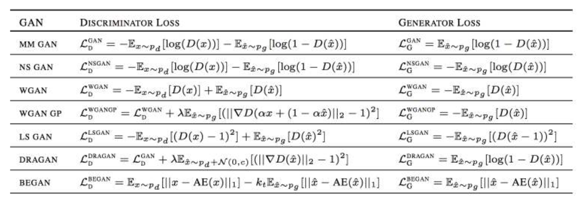
Effect of Different GAN Loss Functions
The most common GAN loss.
The models were evaluated systematically using a range of GAN evaluation metrics, including the popular Fréchet Inception Distance, or FID.
The result suggests that the difference in the choice of loss function disappears when the other concerns of the model are held constant, such as computational budget and model configuration.
Notes:
Surprisingly, they discovered that all evaluated loss functions performed approximately the same when all other elements were held constant.
This does not mean that the choice of loss does not matter for specific problems and model configurations. Instead,

Slide 13
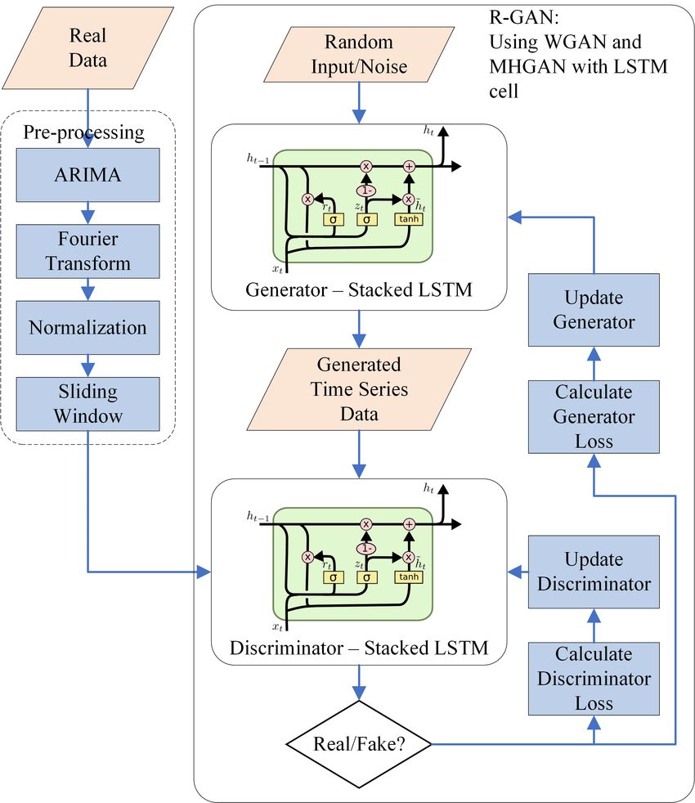
Next:
Exploration into GAN Related Research
Preston: Recurrent GANs for image generation between frames of unknown samples. (ex. Heat interference in IR camera data)
Durant: cGANs for added data anonymization security
Christian: Style GANs for synthetic image generation for missing data samples

